Slide 1

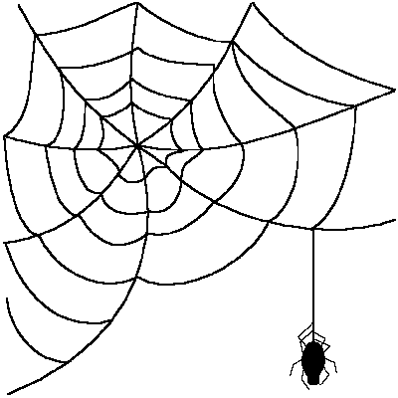







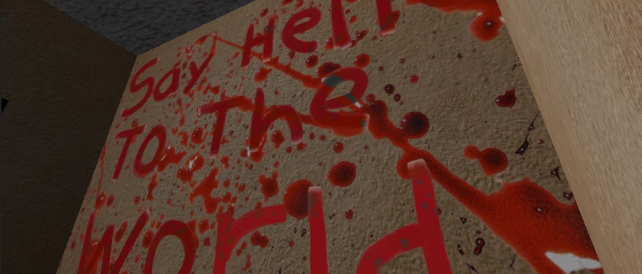

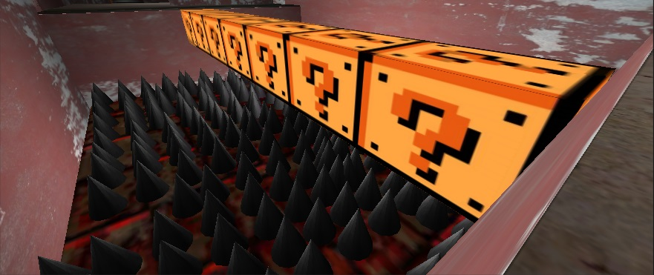

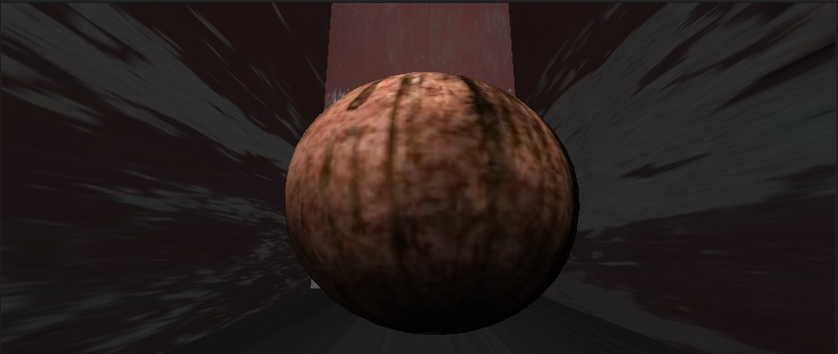
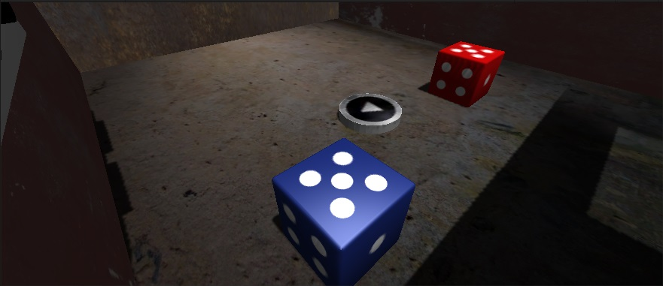
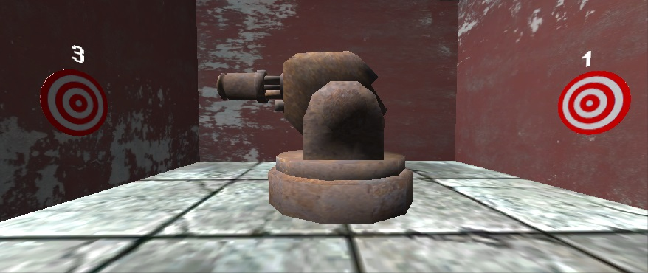
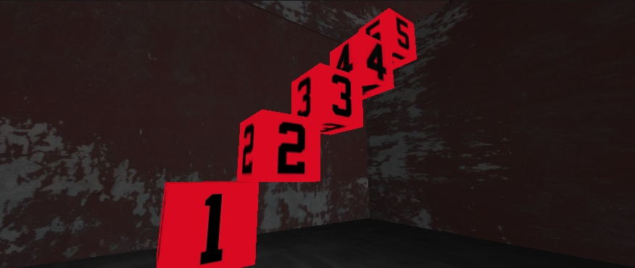
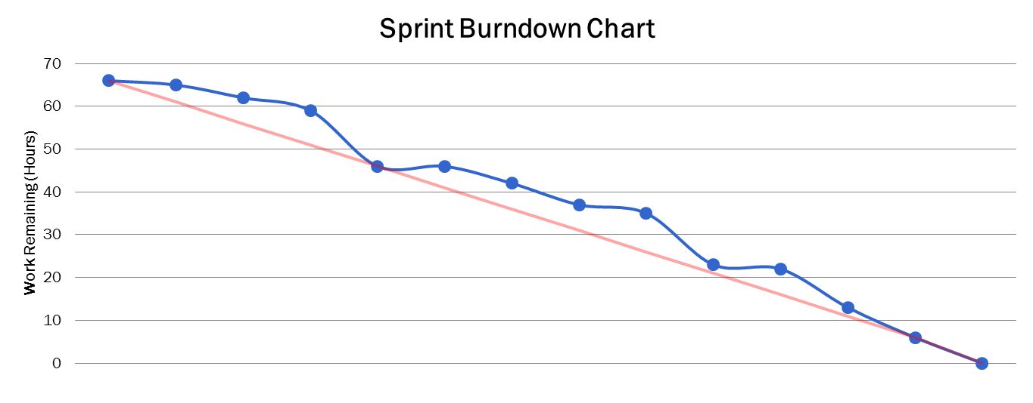
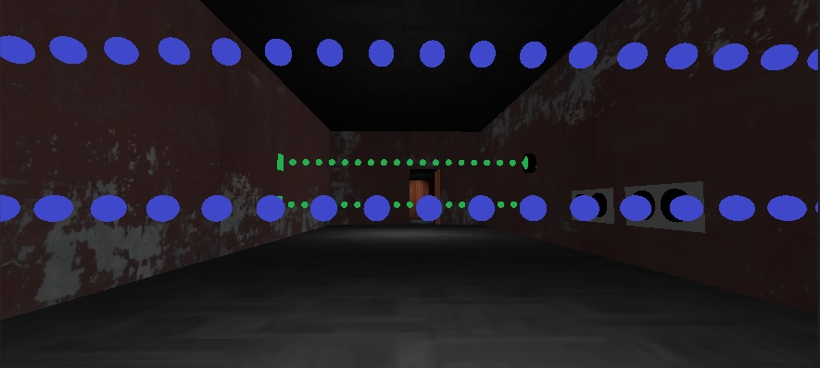
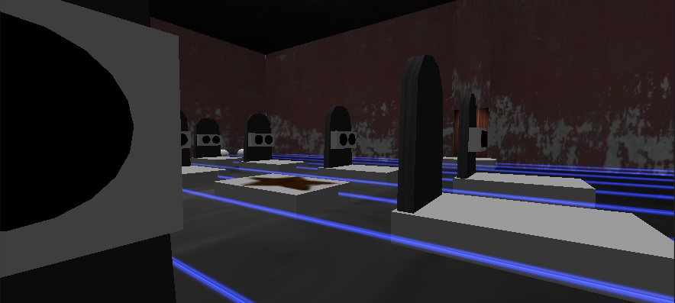



CodeEscape
The funner way to learn Java
Team Members: Kasun Hettiarachchi, Abel Lawal, Ernie Ledezma, Oscar Lugo, Dani Odicho, Jose Pech, Joseph Peña, Tariq Rafiq. Faculty Supervisor: Patricia Dousette
ABSTRACT
MOTIVATION
DEVELOPMENT TOOLS
CodeEscape is a 3D first person puzzle game that that serves as a fun but challenging way to introduce the basic concepts of programming to this audience.
The game was coded in C# using Unity 3D engine.
The player has Robot arms that can be used to “Jack In” to the console object in order to view and interact with Java source code. The player must solve puzzles by understanding and modifying Java code. Lessons are embedded in a scary and engaging world consisting of 10 levels. Users will learn everything from the simple “Hello World” program, to more advanced and theoretical concepts such as Object Oriented Programming. The game also focuses on the intangible elements of coding such as nomenclature and indentation amongst others, all key elements of good style. CodeEscape provides a new and interesting way to bring awareness of the true nature of programming to a completely different audience, and hopefully in time, inspire the next generation of developers. It is not easy to make a game both educational and fun, but we succeeded to achieve that by giving our game a horror theme and by adding humorous features and sound effects to keep the user interested in the game.
Inspire the next generation of developers:
The creation of CodeEscape required the utilization of a variety of different tools:
3D game engine used to build the game.
To provide the right aesthetic look to the game, including textures, model, and animation.
The main IDE used to write th scripts of the game.
Used as source control mechanisms, and to keep track with the documentation
CodeEscape makes the world of programming appealing to a broader audience. It provides the audience with the logical and analytical skills required to fully grasp the fundamentals of programming. It is an informal way to learn the formal rules of programming.
Group Motivation
Our desire to provide a fun learning experience that vastly differs from the texts and tutorials that are so often found as introductions to programming.
Class Activity
Our product can be used by teachers who are teaching introductory courses to programming. The game will be a great tool that reinforces the material that students learn in class.
THE GAME
SOFTWARE ENGINEERING PROCESS
CONCLUSION
These are screenshots highlighting some of the elements found in the game. All of these elements either add to the “horror code” theme of the game. Or they are part of puzzles each used to illustrate a different aspect of coding fundamentals.
Agile Methodology
CodeEscape is a fully functional game, with 10 unique fully playable levels. Each level introduces and explains a different programming concept.
The game is robust having being developed with a powerful game engine and is very easy to install.
The game responded well to testing and has the potential to be a teach tool or a study aid for introductory programming classes
Overall the project was a success as we fulfilled the goals that we had set at the start of the project. The project took on a life of its own as it progressed and this game has turned into more than the team ever envisioned.
Group Member Assignments
Product Owners: Dani Odicho & Ernie Ledesma Scrum Master: Tariq Rafiq
Sprint length: Two (2) weeks.
The scrum master appointed tasks for every sprint, each member handled one aspect of the game that he became familiar with.
We completed one puzzle during each sprint.
After the completion of every sprint the product owners would review the game and see if it aligned to the original goals of the project.
Progress of each sprint was tracked using the MIT schedule, which allowed us to create Sprint Burndown charts.
Using these burndowns we were able to monitor productivity and alter the schedule in order to make sure that the optimal progress was achieved every sprint.
Communication between the team members is the key to the project’s success.
Puzzle 1 - Hello World Puzzle 2 - Indentation
Puzzle 3 - Ints and Doubles Puzzle 4 - Console I/O
FUTURE PLANS
Puzzle 5 - If Statements Puzzle 6 - Random Number Generation
Enhanced Artwork. The primary focus thus far has been on the functionality of the game. Though the current artwork in the game is great, there is always room for improvement
Mobile Version. The average young person is using less time on a desktop and more time on a mobile device, therefore a mobile version of this game would greatly improve its appeal to the younger audience.
Expanded Concepts & Levels. Additional levels could cover intermediate to advanced concepts .
Pitch the product to teachers. To get their feedback and see if they are interested to use it in their classes.
Puzzle 7 - Loops Puzzle 8 - Arrays
Puzzle 9 - Object Oriented Puzzle 10 - Cumulative Quiz
Burndown Chart for our first sprint (September 8 - September 22)

